Slide 1
Music Player
Made by :
Vinayak Pahujani – 2K18ECUN02006
Ria Mittal – 2K18CSUN01076

Slide 2
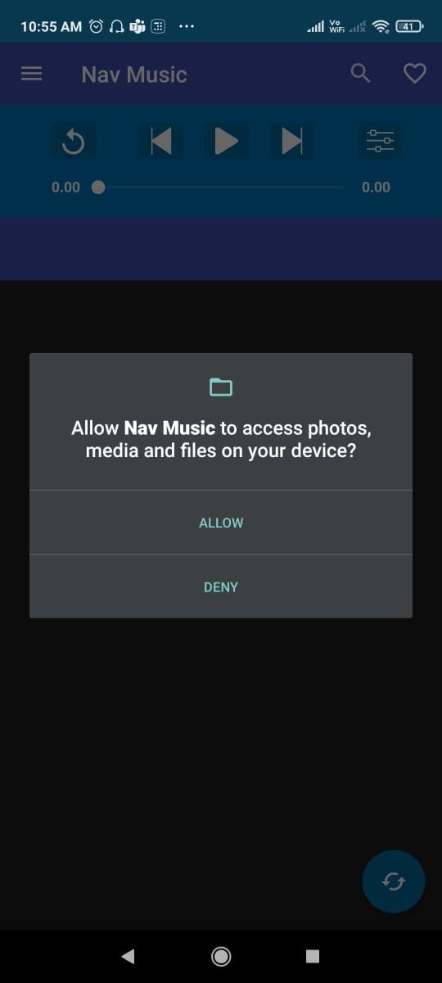
Permission for Storage
Once you install the app , it will first ask you for the permission for accessing storage files, so that it can fetch songs from your device and show them in your playlist.

Slide 3
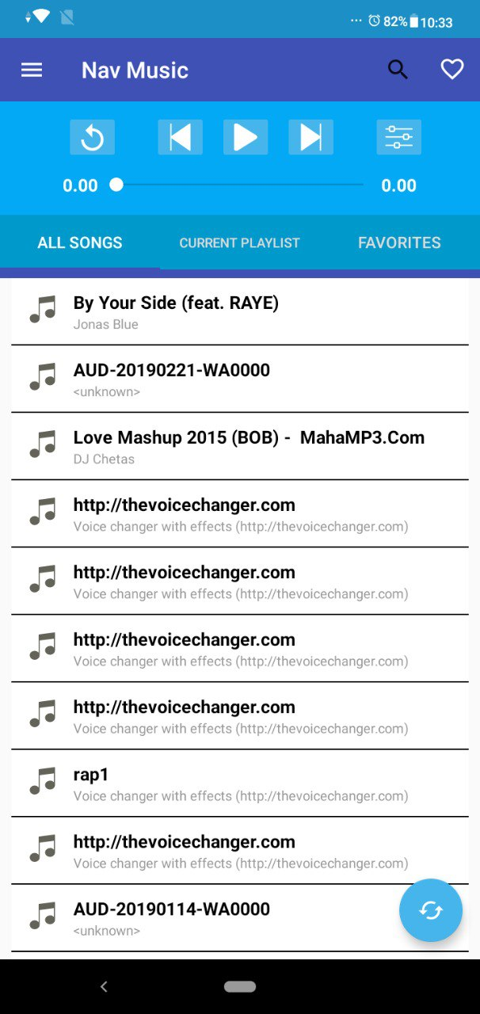
Landing Page of the Music Player
You can see a variety of options and views on the homapage

Slide 4
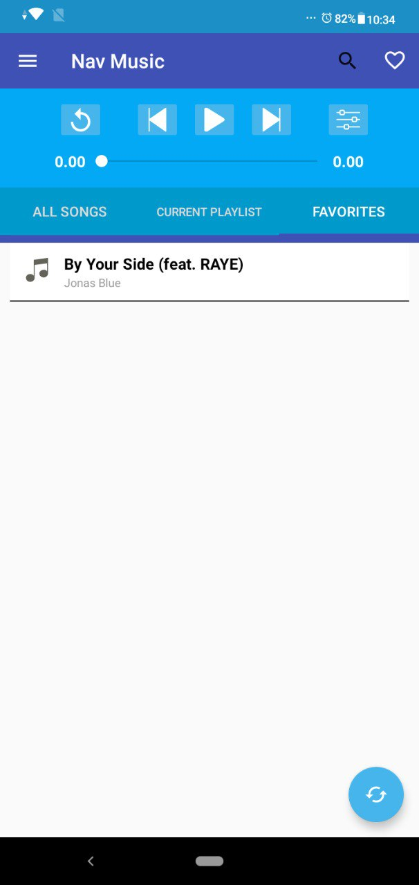
Favourite Songs Section
You can easily add songs from your playlist to the favourites by simply clicking on the heart symbol in the upper right corner

Slide 5
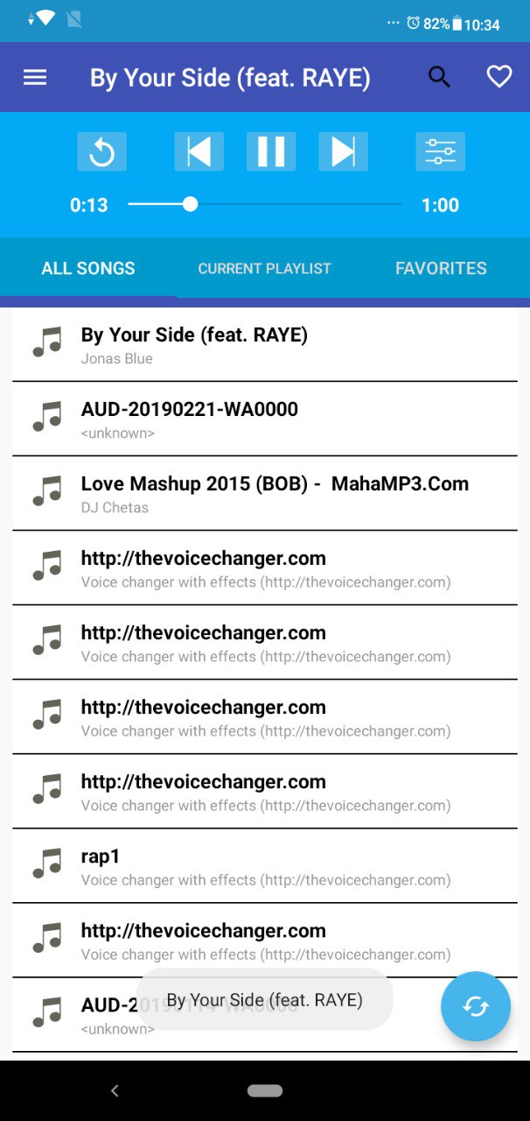
Refresh your playlist
You can refresh your songs view list incase if any new songs doesnt come up in the list view.

Slide 6
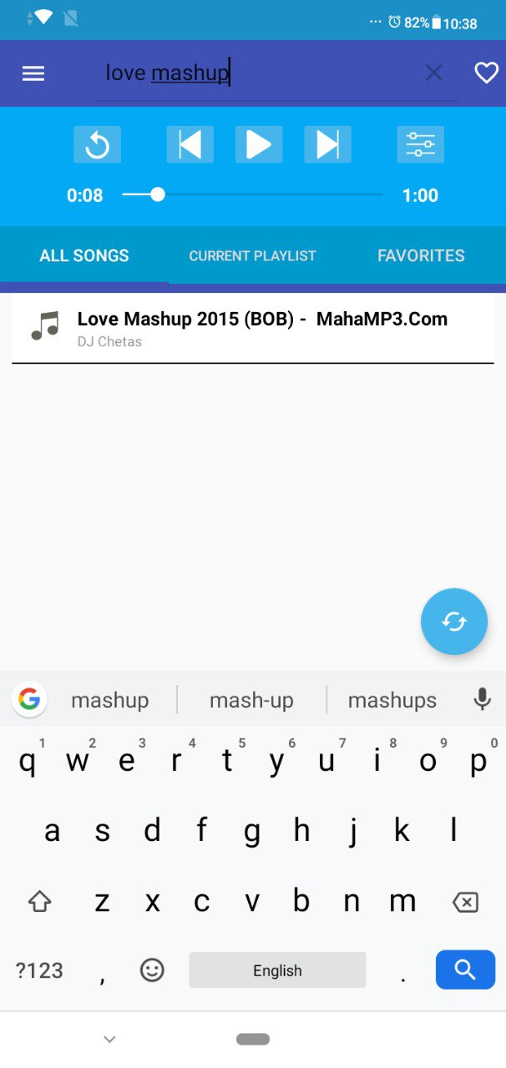
Search your Music
You can easily search songs from your playlist by using the search bar.

